Slide 1

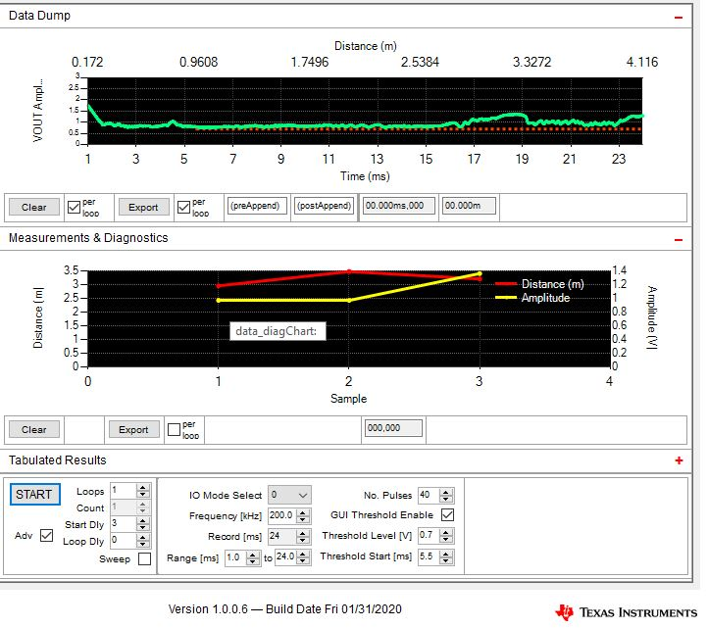
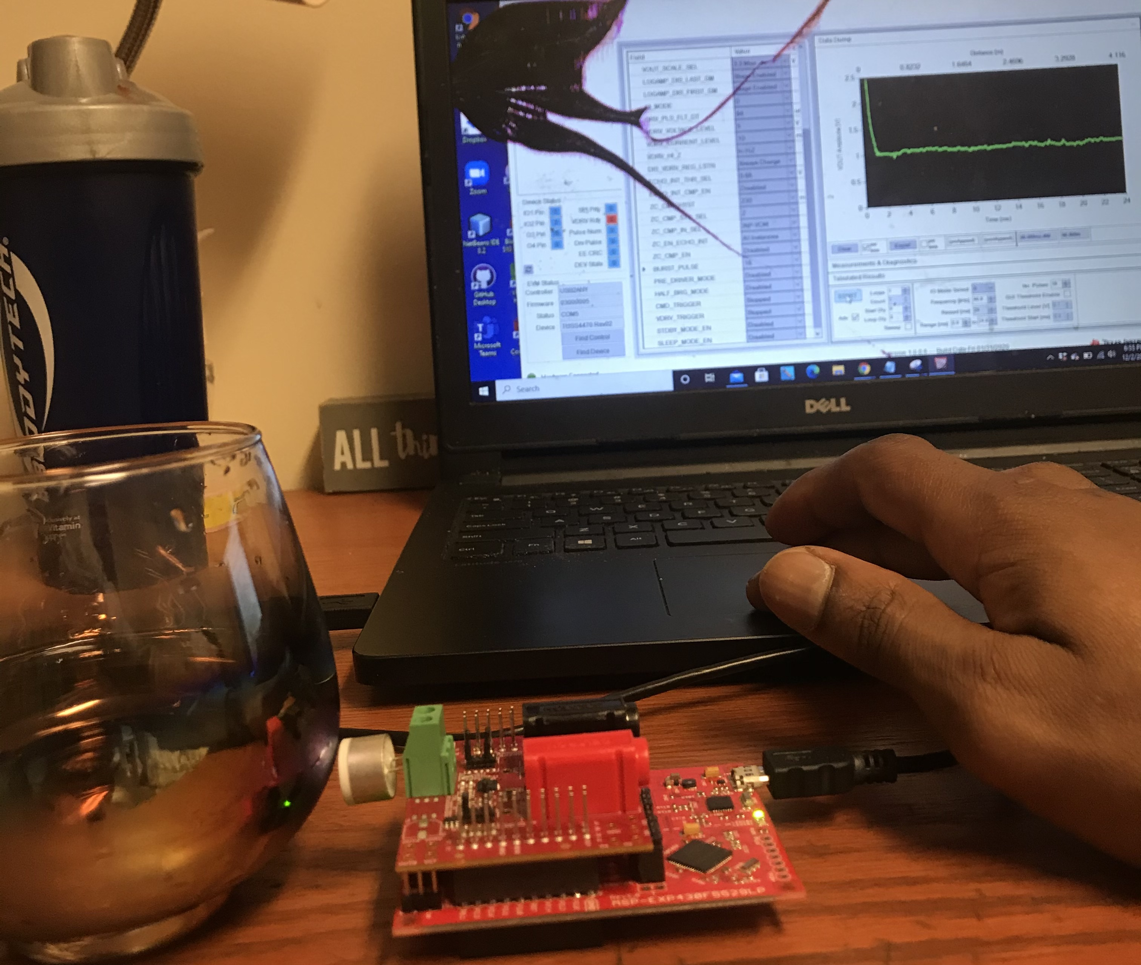
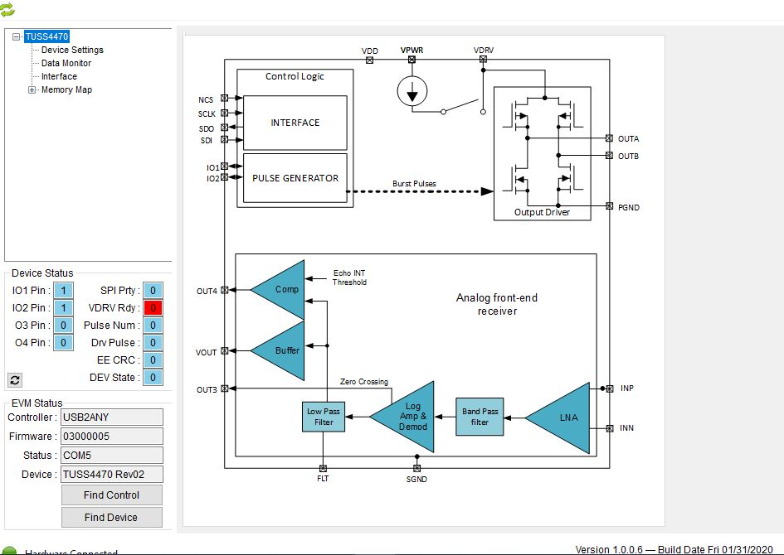
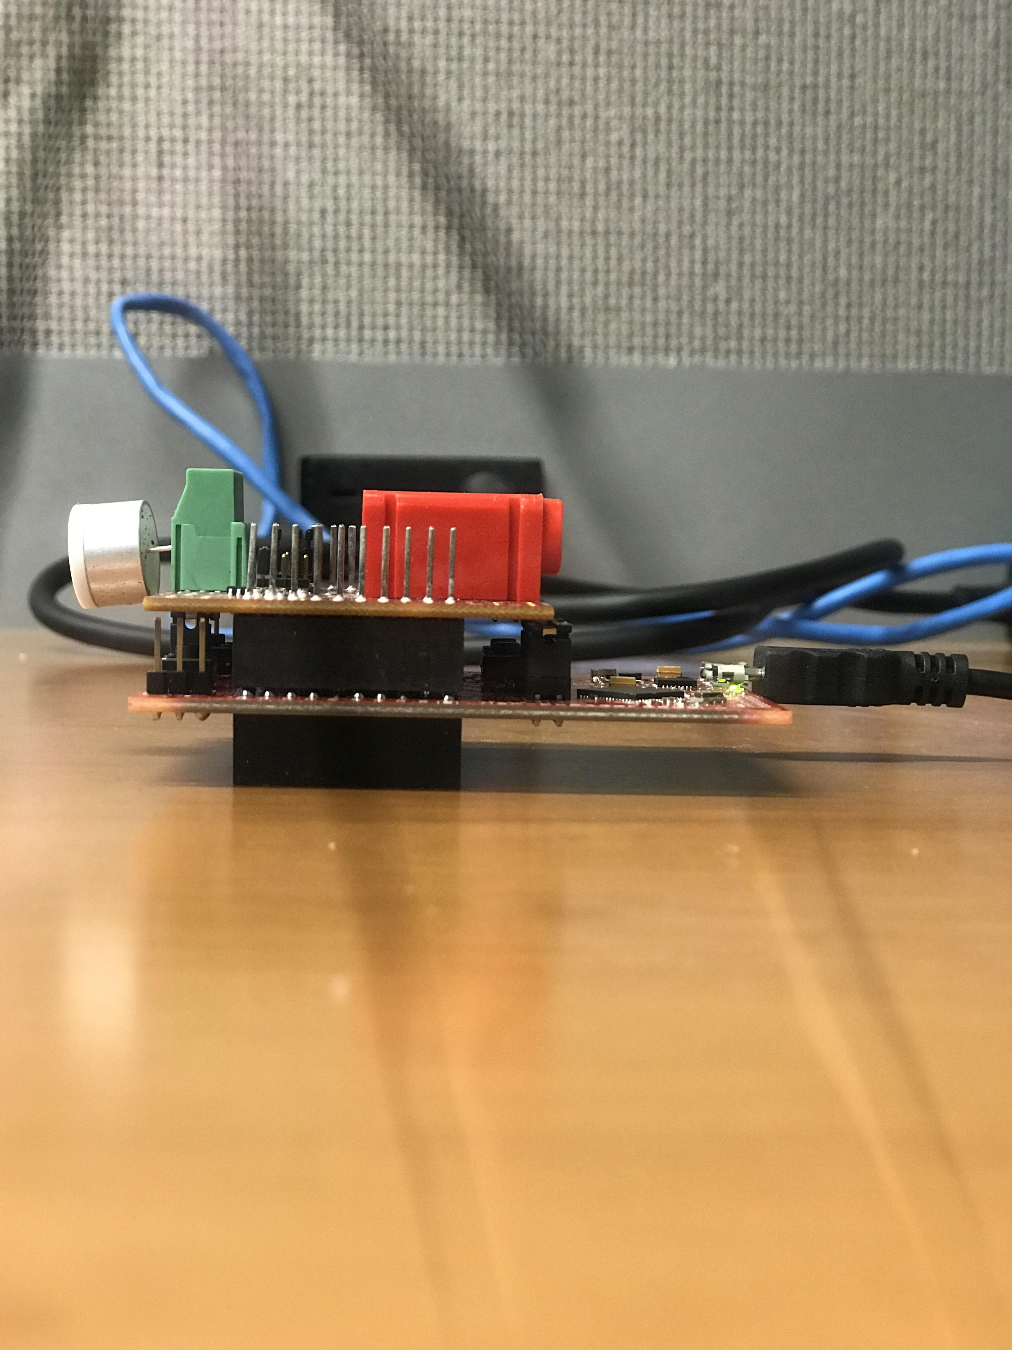
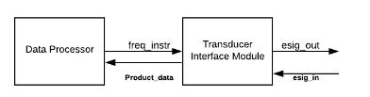
  Ultrasonic Flowmeter Sensing
  Electrical and Computer Engineering Department
  Team Name: Anthony Carthen
  Advisor/Customer: Dr. Bogale
DESIGN PROBLEM
DESIGN IMPLEMENTATION
RESULTS
Problem Statement
Wouldn’t it be nice to not have to sniff the milk to check if its spoiled? Can we go by the UPC label always, before taking a sip of what tastes like uncertainty. There is a need to create a product that can assist the assessment of consumable products that could be passed its own shelf life.
Probing the liquid to test for impurities is not efficient as we can not open break the tamper guards on a grocery container. We must create a design that does not risk cross contamination reusing the same test equipment for different liquids.
Design Objective
We propose to create a design that does not cross contaminate packaged groceries, evaluates as good or bad, and saves the test readings.
Design Criteria/Engineering Requirements
The device should be non-invasive to the product being measured.
The device will have constant low power consumption
The device should have permanent data storage
Through our understanding of ions in liquids, we plan to leverage the frequency of liquids to draw parallels and ultimately a conclusion on the shelf life cycle the liquid is in.
A GUI monitors the device status by periodically reading back the device status registers. All status error bits must read a given state for the device to be in the normal or working state, and is indicated by a blue back color. If any of the status bits read an irregular state, an operational fault exists or the register map is corrupt, and the device may not function properly, and is indicated by a red back color. The Device status automatically updates after each time of flight command measurement.
Testing Results
Figure 3 & 4. Test Data showing 2nd impurity Test with glass of milk to test if different background would affect results
Final Project Prototype
DESIGN ARCHITECTURE
Figure 2. Detailed Design for the Project
DISCUSSION/CONCLUSION
These results suggest that with any measurement of any liquid, the actual impedance value can be found real time for a real evaluation of if the liquid is consumable or not.
This development is important because it gives customers and retail grocery stores a way to scientifically ensure the product liquids being sold have the same nutritional value when ordered, to when it is consumed.
Future development should focus on the memory storage and measurements vs contaminated products.
Figure 1. The image above shows the Level 1 Block Diagram ….
College of Engineering Senior Design Expo - Fall 2020
Instructor: Dr. Corey Graves

